Slide 1
Harmony in the Self (I)

Slide 2
Activities of Self (I) eSa dh fdz;k;sa
 | Force / Power cy@“kfDr | Activity fØz;k
1. |  | Realization vuqHko
2. |  | Understanding cks/k
3. | Desire bPNk | Imaging fp=.k
4. | Thought fopkj | Analysing fo'ys"k.k
5. | Expectation vk'kk | Selecting/Tasting p;u@vkLoknu
Self verification on the basis of Natural Acceptance
lgt Loh—fr ds vk?kkj ij tkap dj
Self (I) eSa
3
Preconditioning
ekU;rk
1
Partantrata
ijra=rk X
Swatantrata
Lora=rk √
Imagination
dYiuk”khyrk
Body 'kjhj
2
Sensation
Laosnuk
Behaviour O;ogkj
Work dk;Z
Partantrata ijra=rk X

Slide 3
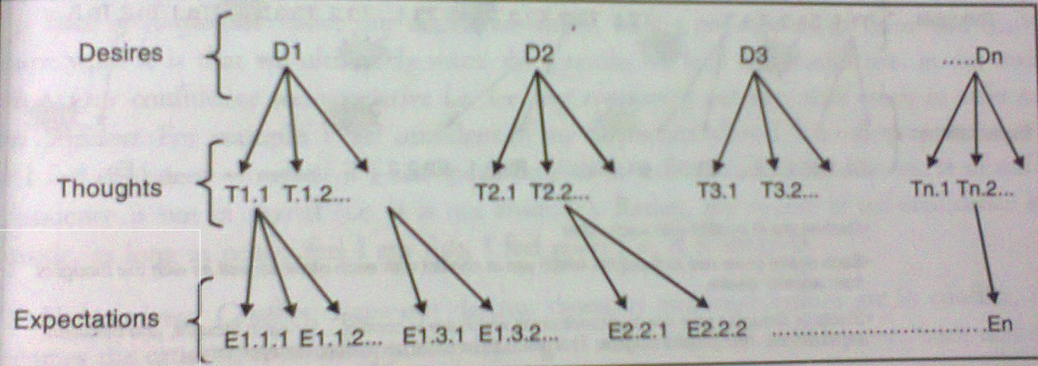
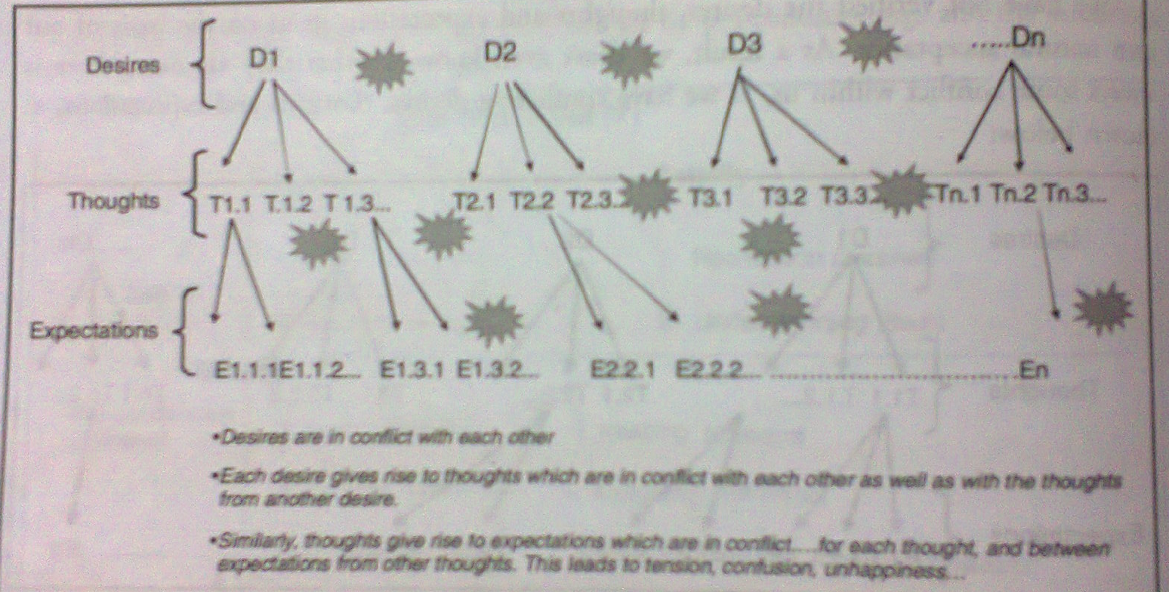
Desire, Thought and Expectation in the Self
Observe the desire, thought, expectation (selection/taste) every moment.
Is it like this?

Slide 4
Practical: List of Desires
Make a list of your desires
Categorize them as
  Need of Self (I) or need of Body
  Where are they originating from – Preconditioning, Sensation or Natural Acceptance

Slide 5
Sum Up
The Self(I) has continuous activity of Desire, Thought & Expectation, together called Imagination
Behaviour/Work is an outcome of Imagination
Imagination is motivated by Preconditioning, Sensation or Natural Acceptance
There is definiteness in imagination, if it is on the basis of Natural Acceptance. Then the behaviour/work is also definite. It is a state of Swatantrata
Imagination based on preconditioning or sensation is not definite. Then the behaviour/work is also indefinite. It is a state of Partantrata

